Slide 1
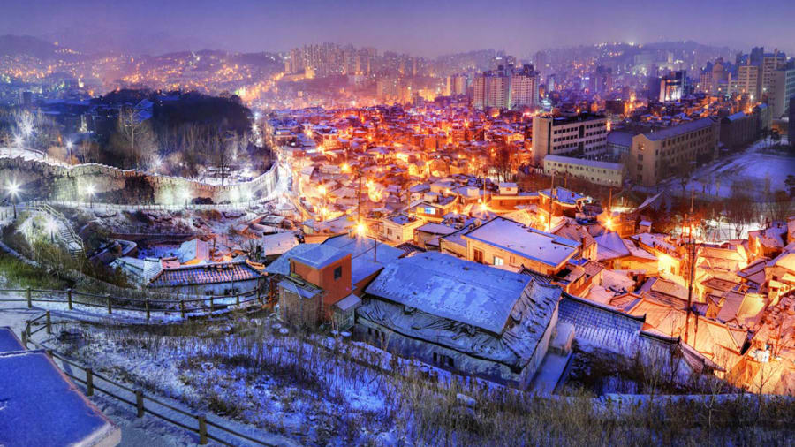
By: Jiwon Chun
South Korea
(Travel, Food, origin, Tourism)

Slide 2
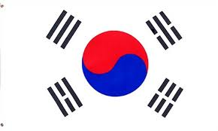
Why I chose South Korea!
I chose South Korea as it is my my home country
My parents and my families were born there
My heritage is 100% Korean

Slide 3
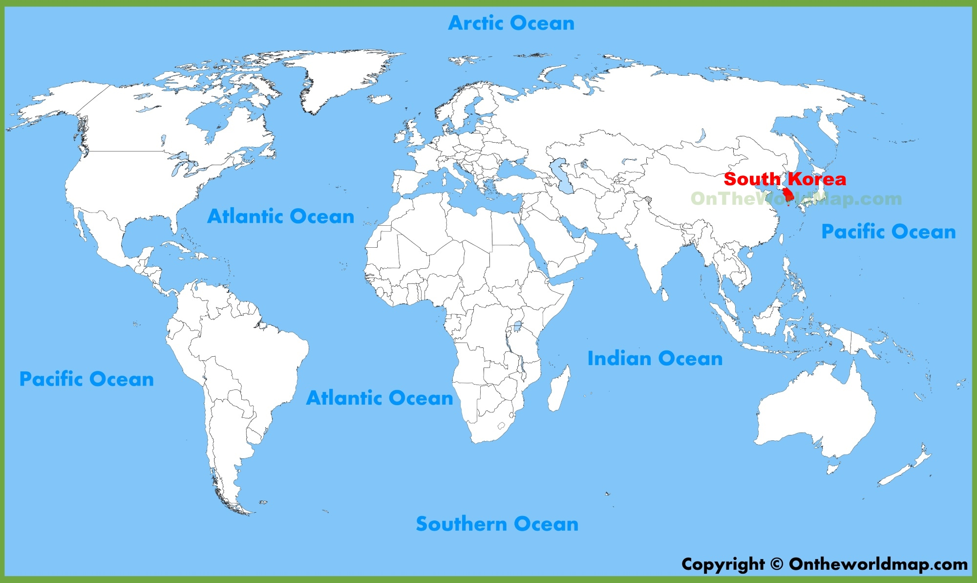
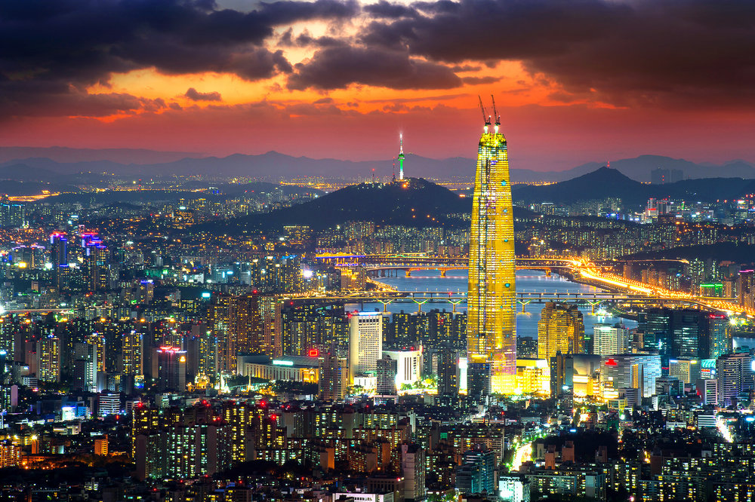
The Basic Info about South Korea
Nation: East Asian nation
Population: 51 million peoples
Located In Asia beside North Korea
Capital: Seoul
Official Language; Korean
President: Moon Jae In

Slide 4
The Origins of South Korea in the Past
Around A.D. 668, several competing kingdoms were unified into a single dominion on the Korean Peninsula.
Successive regimes maintained Korean political and cultural independence for more than a thousand years; the last of these ruling kingdoms would be the Choson Dynasty (1392-1910).
There were three main kingdom of Korea such as Joseon, Silla, Goryeo
They all came as one sometime and it was peaceful not until the Japan came to colonize South Korea.

Slide 5
Korea under Japan Rule
South Korea were under Japan ruling after they colonize it
outset of the 20th century, Japan, China and Russia vied for control over the Korean Peninsula.
Japan emerged the victor, occupying the peninsula in 1905, five years later.
Over 35 years of colonial rule, Korea became an industrialized country,
people suffered brutal repression at the hands of the Japanese,
who tried to wipe out its distinctive language and cultural identity and make Koreans culturally Japanese.
During World War II, many Korean men were compelled to serve in Japan’s army, work in wartime factories,
while thousands of Korean women were forced into providing sexual services for Japanese soldiers, becoming known as “comfort women.”

Slide 6
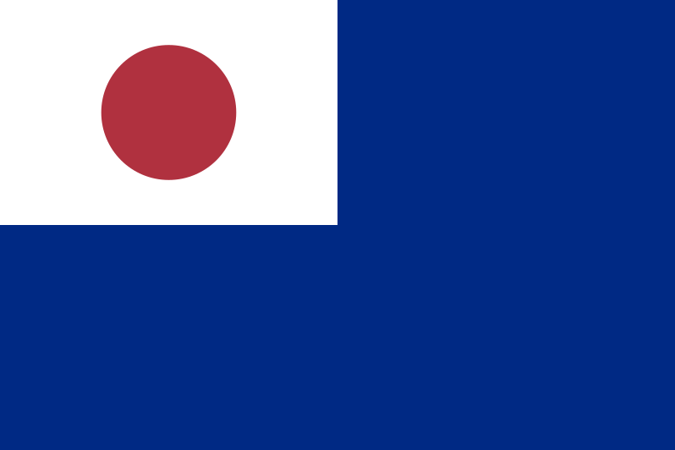

Slide 7
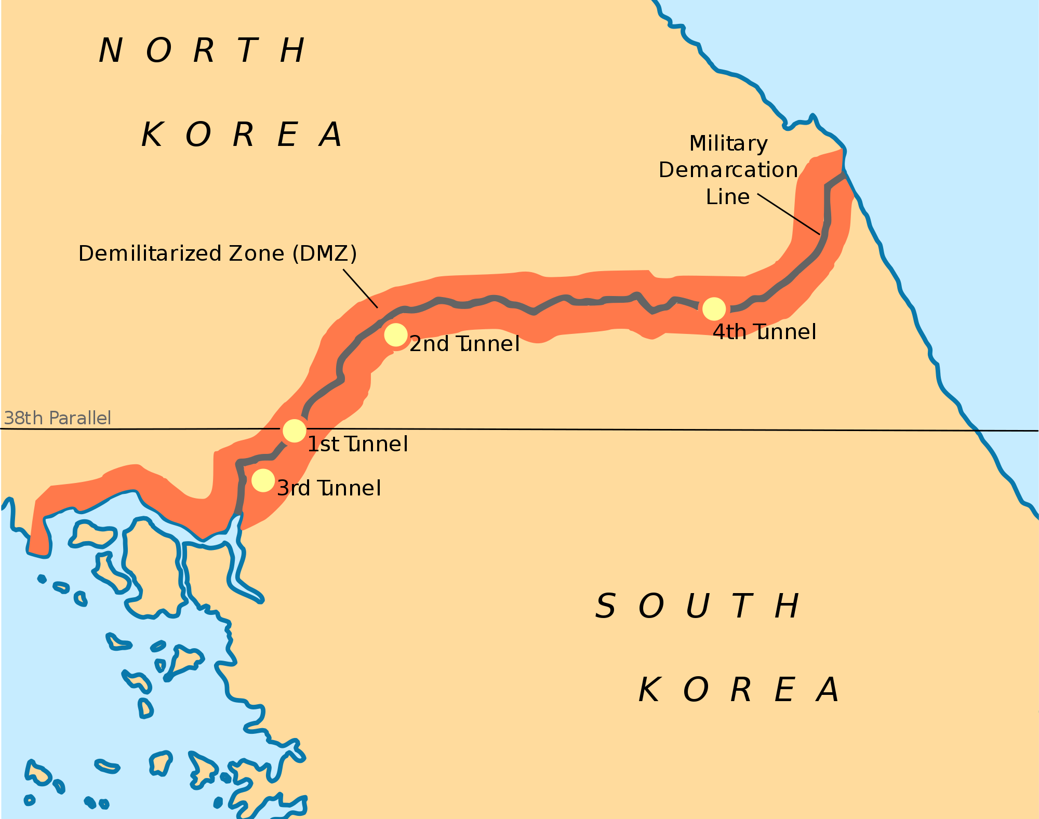
Korea divided
After Japan’s defeat in 1945, the United States and the Soviet Union divided the peninsula into two zones of influence.
By August 1948, the pro-U.S. Republic of Korea (or South Korea) was established in Seoul, led by the strongly anti-communist Syngman Rhee.
In the north, the Soviets installed Kim Il Sung as the first premier of the Democratic People’s Republic of Korea (DPRK), better known as North Korea, with its capital at Pyongyang.

Slide 8
Korean War
South Korea’s declaration of independence in 1950 led North Korea, backed by China and the Soviet Union, to invade its neighbor in an effort to regain control of the entire peninsula.
U.S. and United Nations troops fought alongside South Korean forces in the Korean War, which would cost some 2 million lives before it ended in 1953.
The armistice agreement left the Korean Peninsula divided much as before, with a demilitarized zone (DMZ) running along latitude 38 degrees North, or the 38th parallel.

Slide 9
Traditional Holiday & Celebration
Seollal: Is the first day of the Korean Lunar Calendar
It is one of the most important traditional Korean holidays.
The celebration usually lasts three days: the day before Korean New Year, Korean New Year itself, and the day after Korean New Year.
During this time, many Koreans visit family, perform ancestral rites,
Wear hanbok, eat traditional food, and play folk games.
Additionally, children often receive money from their elders after performing a formal bow

Slide 10
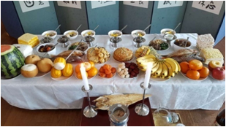
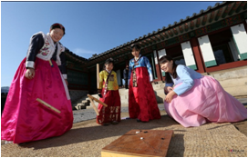

Slide 11
Independence Day or Gwangbokjeol
Gwangbokjeol literally means “The day the light returned“, symbolizing South Korea’s freedom from the Japanese Imperialism in 1945.
Needless to say, it’s a very important day for Koreans, in fact National Liberation day (Gwangbokjeol) is also celebrated in North Korea by the name which literally means “Liberation of Fatherland Day“.
South Koreans celebrate this special occasion by raising the Korean Flag, almost everywhere, you might have seen it in the streetlights or hanging in trees.

Slide 12
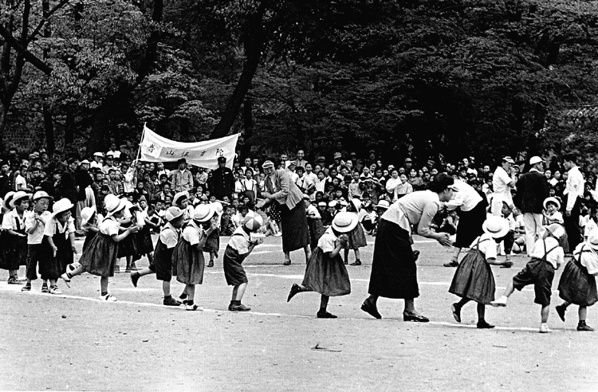
Children’s Day
5 May is officially recognized as Children's Day. Parents often give presents to their children, as well as spend time with them. The children are taken on excursions to zoos, museums, and various venues of children-oriented entertainment.
Children's Day was first conceived by innovative Korean students and social leaders on the basis of the March 1st Movement to achieve Korean independence from Japanese colonialism.
And by 'the law of holiday of government office', Children's day became a holiday in Korea in 1970.[

Slide 13
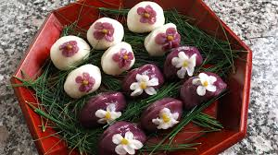
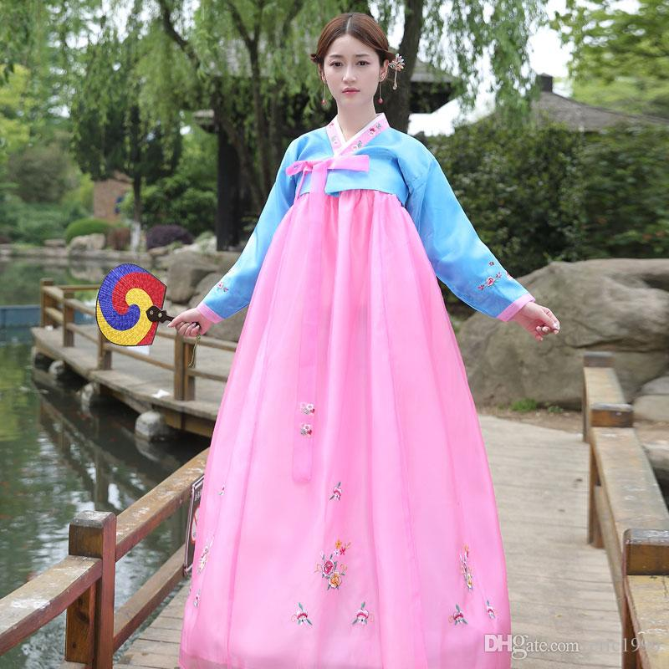
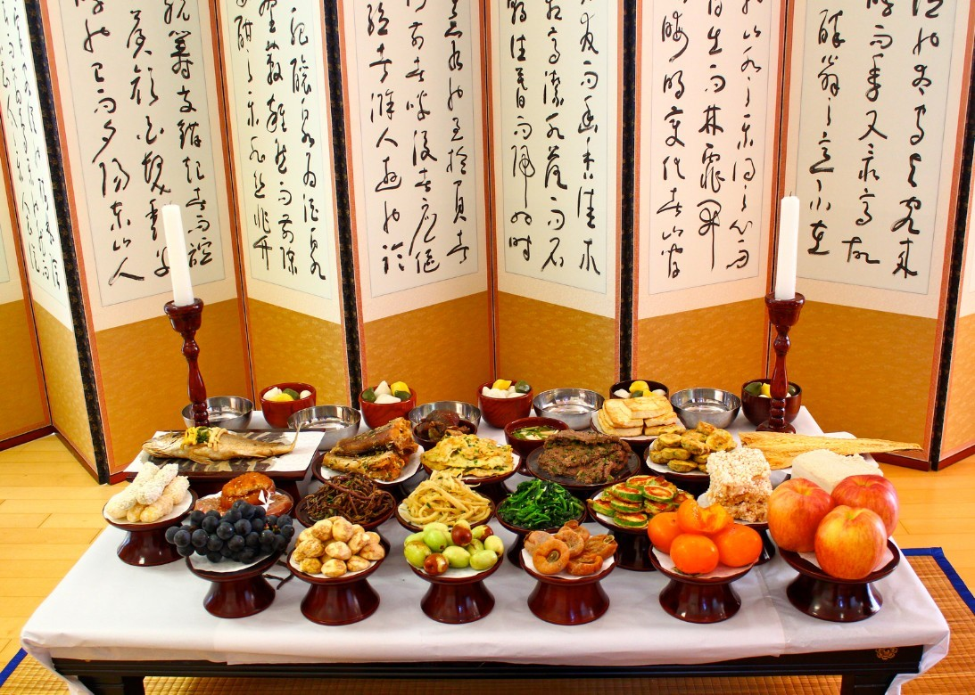
Chuseok
Korean Thanksgiving
Wear Hanbok
Eat food like Songpyeon(Korean Rice Cake with filling, Tteokguk(Korean Rice Cake Soup))
Last three days in total

Slide 14
Hangul Day
October 9, is Hangul Day, possibly the only holiday devoted to celebrating a writing system in the world!
The holiday commemorates the invention of the Korean alphabet, Hangul
in 1446. Until King Sejong of the Choson Dynasty (1392-1897) mandated that a native writing system should be developed
Korean had no official written form. Classical Chinese was the lingua franca for the literate classes.
It symbolizes as the day where we appreciate him for creating Hangul

Slide 15
Foods
1. BULGOGI ( sliced meat strip and marinated to have a sweet, spicy flavor)
2. KIMCHI ( Cabbage with spicy/sweet seasoning)
3. HAEJANGGUK( Hangover Stew where you eat after having a alcohol in the morning. From Beef Broth and vegetables.)
4. SAMGYEOPSAL( Pork Belly)
5. BIBIMBAP ( Rice with variety vegetables plus with spicy Korean sauce)
6. SAMGYETANG ( Chicken and Ginseng soup with chicken and ginseng and rice)
7. JAPCHAE ( glass noodles from sweet potatoes with meat and veggies)
8. HOTTEOK ( Pancake type Korean dessert with sweet filling inside)

Slide 16
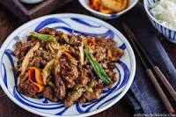
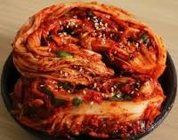
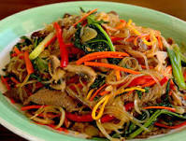
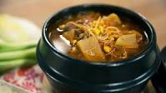
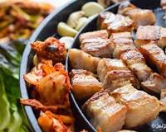
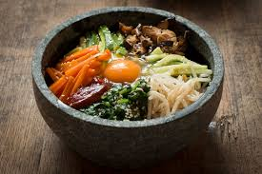
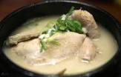
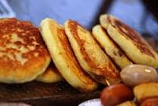

Slide 17
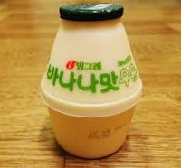
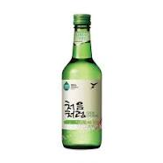
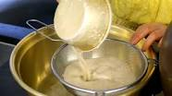
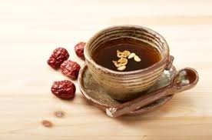
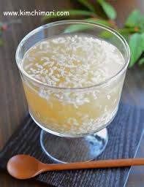
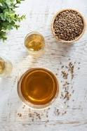
Drinks
Banana Milk
Soju( water typed alcohol)
Makgeolli ( Korean Rice Wine)
Cheongju( Clear Liquor)
Citron Tea
Dried Jujube tea
Green Plum Tea
Barley tea
Sikhye( Cold Rice Drink)

Slide 18
Musics
There is two type of Korean music right now
Traditional(past) and Kpop as in Korean Pop music(present)
The term gugak translates into “national music”
comprises roughly of two bigger genres, folk music and court music.
Today, we also have newer additions to Korean Music, Changjak-gugak or Shin-gugak
newly-composed Korean traditional music and fusion gugak, with western elements.
K-pop (an abbreviation of Korean pop or Korean popular music) is a musical genre consisting of electronic, hip hop, pop, rock, and R&B music originating in South Korea
In addition to music, K-pop has grown into a popular subculture among teenagers and young adults throughout Asia, resulting in widespread interest in the fashion and style of Korean idol groups and singers

Slide 19
Business Cultures
Alway have to greet and no hand shaking ( bow down 30 - 40 degree)
Greeting ( leg together, hands straight down on the sides)
Person with higher status( initiate handshake, take it with both hand)
Alway give a Business Card to anyone you are meeting( give a business card with both hands and with the face up so it is easier to read)
Business Card should have full name, your title and the position clear
Appointment and Punctuality ( South Korean values Punctuality the most and should alway be on time)
Dress code is alway dark colors
Never talk about Korean Politics, Korean War, Communism, Personal family matter
Never compliment people over, never points finger at anyone, never make direct eye contact for a long period of time when having a conversation

Slide 20
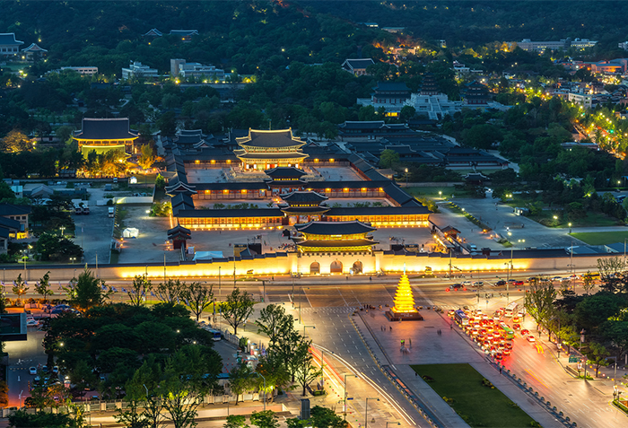
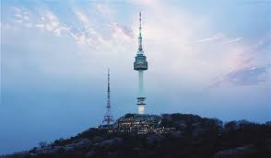
Tourisms
Gyeongbokgung Palace( palace for the royal family in the past)
N Seoul Tower ( Korean version of Cn Tower)
Lotte World ( Biggest amusement park)
Bukchon Hanok Village( traditional building)
Myeong Dong( districts of fashion)
Hongdae( cultural hub of youth peoples)
The Garden of Morning Calm( garden that represent
Korea beauty through nature.)

Slide 21
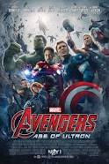
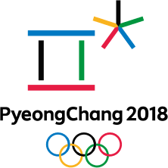
Fun Facts
The American film “ The Avenger Age of Ultron” was filmed in Seoul
The Winter Olympics in 2018 was hosted in Pyeongchang

Slide 22
Websites
https://www.google.ca/search?q=2018+winter+olympics&source=lnms&tbm=isch&sa=X&ved=0ahUKEwiblKz_ofjeAhUH04MKHWJbAqoQ_AUIDygC&biw=1366&bih=657
https://www.britannica.com/place/South-Korea
https://www.korea4expats.com/article-business-practices-etiquette.html
https://www.investopedia.com/articles/forex/040515/north-korean-vs-south-korean-economies.asp

Slide 23
Thank you for Listening

